Slide 1
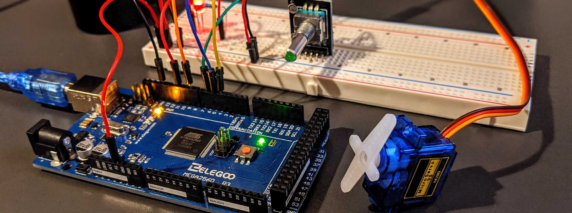




Elevator Call Response System
EEE 304 – Digital Electronics Laboratory
Submitted by – Group 04
Kazi Mubashir Tazwar
1906142
Prantik Paul
1906145
Khondaker Nafis Ahmed
1906147
Manjur Muntasir
1906150

Slide 2
Outline
Summary
Introduction
Design
Implementation
Analysis and Evaluation
References
Feel free to change titles of the individual slides. Also, feel free to use smart art here to make it more attractive
Make sure to change the footers
Presented by: 1906XXX

Slide 3
1. Summary / Abstract
Explain your project briefly. Add pictures of your final project in the slide to help explain better.
Presented by: 1706XXX

Slide 4

2. Introduction
Case - 1
Case - 2
Case - 3
Case - 4
Presented by: 1706XXX

Slide 5
2. Introduction
Case - 1
Flow diagram:
Farthest floor will be detected(3,5 - 5)
Farthest floor(5) will be compared to current floor(1) by using a comparator
Determines that the direction of the lift will be upwards​
Current direction(upwards) matches with floor of consideration's(3-upward) direction
3rd floor call will be answered and will proceed to farthest(5)
Another comparator
Compares between current floor(1) and the other floor(3)​
Presented by: 1706XXX

Slide 6
2. Introduction
Flow diagram:
Case - 2
Farthest floor will be detected(3,5 - 5)
Farthest floor(5) will be compared to current floor(1) by using a comparator
Determines that the direction of the lift will be upwards​
3rd floor call will not be answered firstly and will proceed to farthest call(5) and in the downward direction 3rd floor call will be answered
Current direction(upwards) doesn’t match with floor of consideration's(3-downwards) direction
Another comparator
Compares between current floor(1) and the other floor(3)​
Presented by: 1706XXX

Slide 7
2. Introduction
Case - 3
Flow diagram:
Farthest floor will be detected(2,5 - 5)
Farthest floor(5) will be compared to current floor(3) by using a comparator
Determines that the direction of the lift will be upwards​
Current direction(up) does not match with floor of consideration's(2-up)
direction
2nd floor call will not be answered while going down
After reaching 5th floor another comparator compares between current floor(5) and the other floor(2)
Presented by: 1706XXX

Slide 8
2. Introduction
Case - 4
Flow diagram:
Farthest floor will be detected(2,5 - 5)
Farthest floor(5) will be compared to current floor(3) by using a comparator
Determines that the direction of the lift will be upwards​
Current direction(up) matches with the floor of consideration's(2-up)
direction
2nd floor call will be answered while going down
After reaching 5th floor another comparator
compares between current floor(5) and the other floor(2)​
Presented by: 1706XXX

Slide 9
3.1 Design: Methods
Floor call input
Enable the corresponding priority encoder
Output of encoder according to priority of the calls
Current floor input
AND/OR logic
Output
Presented by: 1706XXX

Slide 10
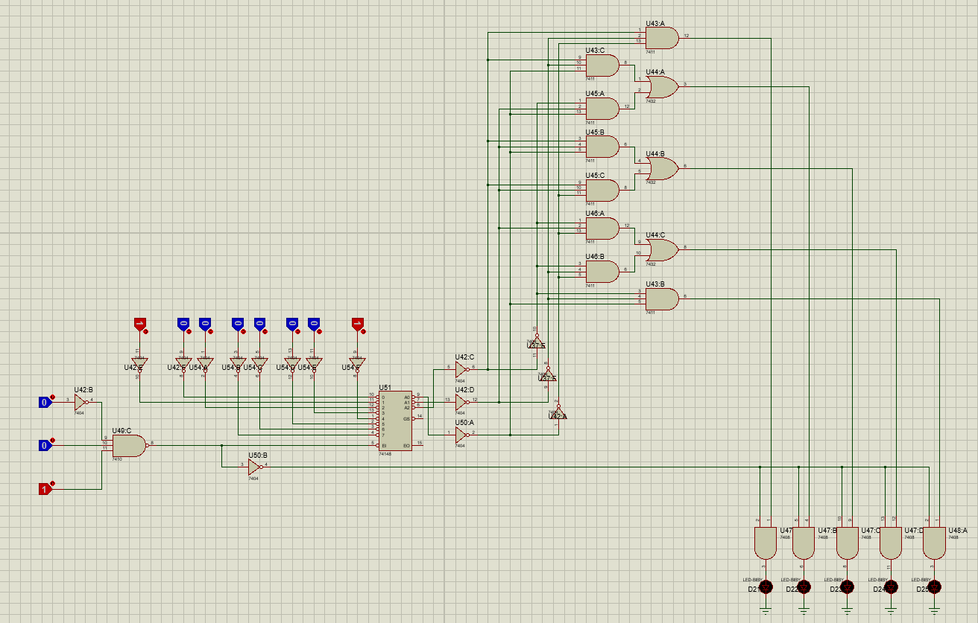
3.1 Design: Methods
Example –
Design for 3rd floor
Presented by: 1706XXX

Slide 11
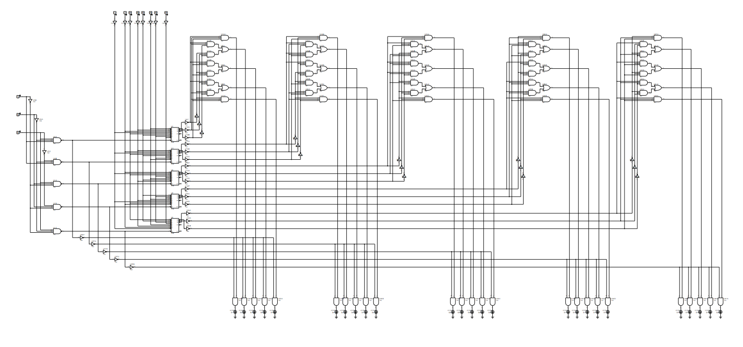
3.2 Design: Circuit Diagram
Presented by: 1706XXX

Slide 12
3.3 Design: Simulation (optional)
If you did simulation, add screenshots / screen captured video in the slide to show key features. For screen captures, you can remove this slide for the video and directly explain in the software. Add screenshots for the PPT file that you will submit
Presented by: 1706XXX

Slide 13
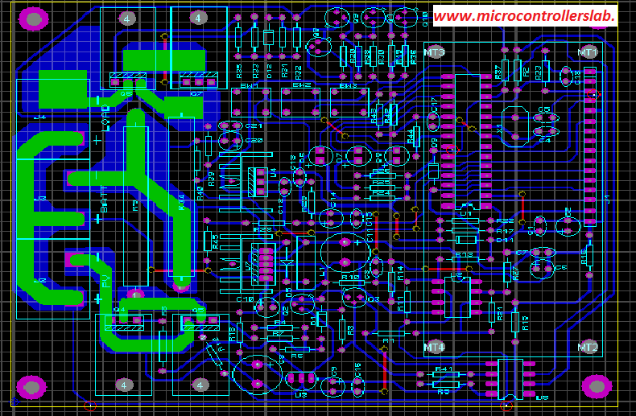
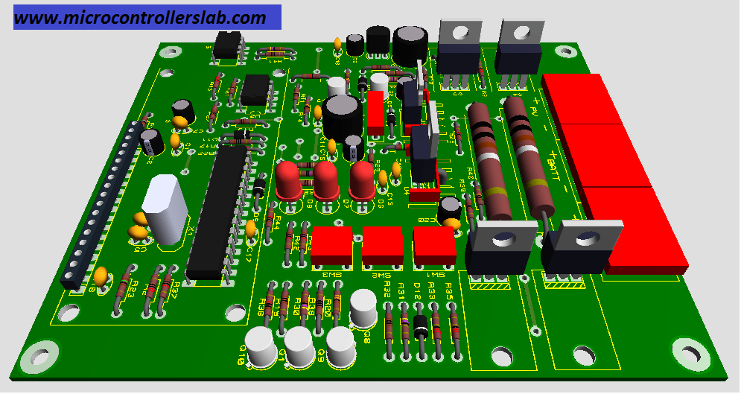
3.4 Design: PCB Layout and 3d rendering
PCB layout design of your project (add picture and briefly show it in video), and 3d rendering.
(in proteus, it is possible to do the 3d render, just take a screen shot of that)
Presented by: 1706XXX

Slide 14
4 Implementation: Demonstration
If you could implement the project in hardware (even in a breadboard), add it in the slide. You may also add a short (no more than 20 second) video
Presented by: 1706XXX

Slide 15
4.1 Implementation: Photo Gallary
Add photos that demonstrate the key features of your project
Presented by: 1706XXX

Slide 16
5. Analysis and Evaluation
5.1 Novelty
5.2 Project Management and Cost Analysis
5.3 Practical Considerations of the Design
5.4 Assessment of the Impact of the Project
5.5 Evaluation of the Sustainability
Presented by: 1706XXX

Slide 17
5.1 Novelty
Presented by: 1706XXX

Slide 18
5.2 Project Management and Cost Analysis
Component | Quantity | Cost
Priority Encoder (74148) | 5
3-Input NAND (7410) | 5
3-Input AND (7411) | 15
3-Input OR (74HC4075) | 10
2-Input OR (7432) | 5
2-Input AND (7408) | 10
NOT (7404) | 12
LED | 25
Switch | 11
Breadboard | 15
Jumper Bundle | 10
Presented by: 1706XXX

Slide 19
5.3 Practical Considerations of the Design
In 1 slide, address these points:
5.3.1 Considerations to public health and safety
5.3.2 Considerations to environment
5.3.3 Considerations to cultural and societal needs
Presented by: 1706XXX

Slide 20
5.4 Assessment of the Impact of the Project
In 1 slide, address these points:
5.4.1 Assessment of Societal Issues
5.4.2 Assessment of Health and Safety Issues
5.4.3 Assessment of Legal Issues
5.4.4 Assessment of Cultural Issues
Presented by: 1706XXX

Slide 21
5.5 Evaluation of the Sustainability
In 1 slide, address these points:
5.5.1 Evaluation of Sustainability
5.5.2 Evaluation of Impact of Design in Societal Context
5.5.3 Evaluation of Impact of Design in Environmental Context
Presented by: 1706XXX

Slide 22
6. Reflection on Individual and Team work
6.1 Individual Contribution of Each Member
6.2 Mode of TeamWork
6.3 Diversity Statement of Team
6.4 Log Book of Project Impelementation
Presented by: 1706XXX

Slide 23
6.1 Individual Contribution of Each Member
Explain what each member of the team did
Presented by: 1706XXX

Slide 24
6.2 Mode of TeamWork and Diversity
Explain how your team is a diverse representation
Also explain how you completed the project as a team. Add pictures if necessary (even funny pictures are okay here).
Presented by: 1706XXX

Slide 25
6.3 Logbook of Project
Briefly show the logbook of your project here (screenshot)
In presentation, just show this slide, no need to explain.
Presented by: 1706XXX

Slide 26
7. References
Add any and all references here, for websites, give URL. Include any research articles, datasheets, handbooks, reference manuals used in the project. In presentation, just show this slide, no need to explain.
Presented by: 1706XXX

